Slide 1
Website Wireframe
Keep it brief, there are designs to show the layout, fonts and colours NOT THE CONTENT

Slide 2
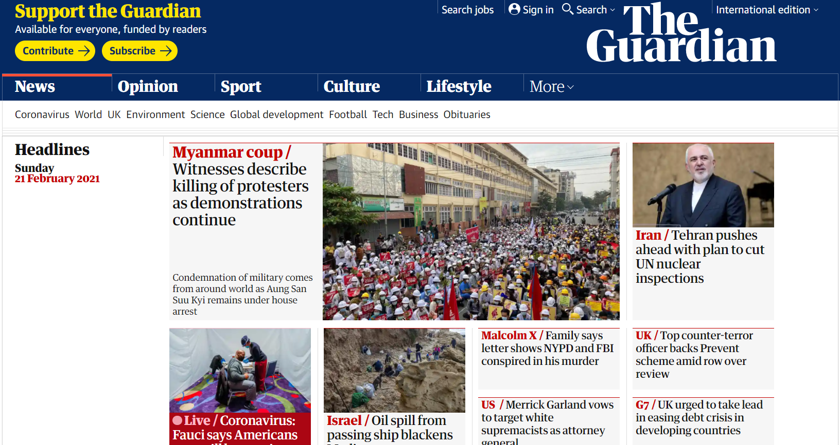
Look at three different websites Identify the common areas
Heading
Navigation
Content
Look for similarities (and differences) in layouts across webpages

Slide 3
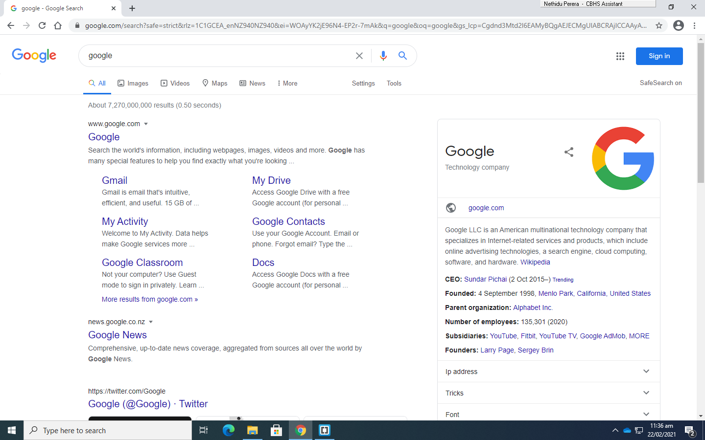

Site 1 -

Slide 4
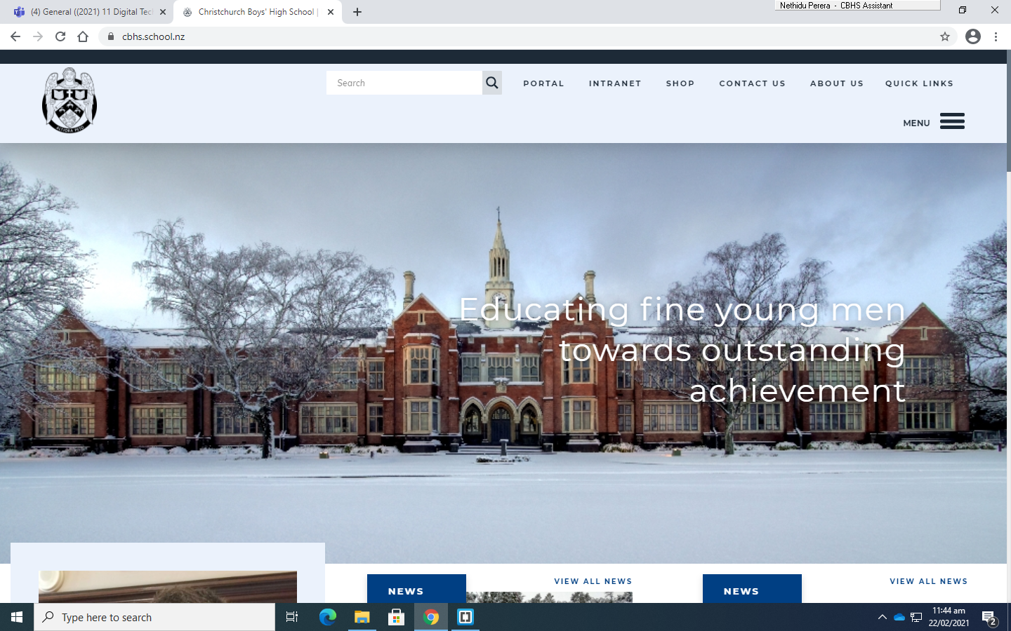



Site 2 -

Slide 5
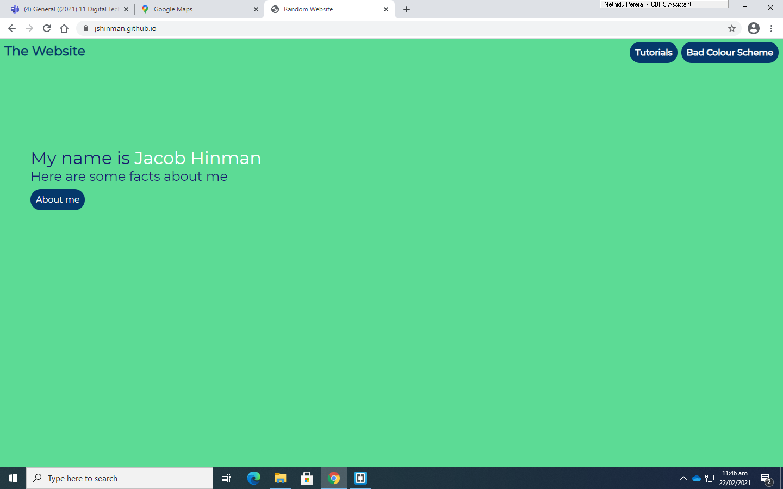




Site 3 -

Slide 6
Site Map (Where the links go)
Home
Page 2
Page 3
Page 2
Subpage 1
Page 2
Subpage 2

Slide 7
Own site map
Home
Page 2
Page 3

Slide 8
Default page style
825px
Centered on page
Title
125px
Navigation Menu
Main Content
175px
825px

Slide 9
Navigation
Explain the look and feel of the navigation of your site
Home
Home
Red background with white text shows current page
Console
Console
Button changes to white background when hovered over.
PC
PC

Slide 10
Home Page (index.html)
825px
Centered on page
Title
125px
Navigation Menu
Homepage Title
Welcome Text
Welcome Image
500x500
175px
825px

Slide 11
Gaming PCs (PC.html)
825px
Centered on page
Title
There will be move examples in the same layout for other consoles
125px
Navigation Menu
Gaming PCs
Xbox
200x150
Text about xbox
500x150
Switch
Text about Switch
175px
825px

Slide 12
Gaming PCs (PC.html)
825px
Centered on page
Title
125px
Navigation Menu
Gaming PCs
Gaming PC image
200x200
Text about gaming PCs
Game
175px
825px

Slide 13
Home Page (index.html)
Full width of screen
Title (left align)
2/15ths
1/15th
Navigation Menu
Welcome banner
6/15
12/15ths
Main content

Slide 14
Home Page (index.html)
Full width of screen
Title (left align)
2/15ths
1/15th
Navigation Menu
Welcome banner
6/15
12/15ths
Main content

Slide 15
Page 2 (???.html)
Full width of screen
Title (left align)
Navigation Menu
2/15ths
1/15th
Header
Text
Image
12/15ths
Image
Text

Slide 16
Page 3 (???.html)
Full width of screen
Title (left align)
Navigation Menu
2/15ths
1/15th
Header
Text
Image
12/15ths
Image
Text

Slide 17
Colour Schemes (https://coolors.co/)
Set out colours for your website
Mountain Meadow (Title) 30BA8F
Teal Blue (Navigation) 367588
Beau Blue (Button hover) bcd4e6
White (Body)
Border colour (yellow)
Light Coral (Header) ff858d

Slide 18
Fonts
Set out font for your website
Headings
Main text

